Slide 1

DECODING AUDOLOGY DATA
Department of Computer Science and Engineering
S R Gudlavalleru Engineering College, Gudlavalleru
Under the Guidance of
G. Keerthi Madam M.Tech (P.HD)
By
T. L. Likitha 21481A05M0
V. Anusha 21481A05P0
Y. Abhilash 21481A05Q1
V. Grace Vijaya 21481A05O4

Slide 2
INDEX
Introduction
Proposed Method
Result
Conclusion and Future Scope

Slide 3
Abstract
Hearing and balance disorders are prevalent conditions affecting individuals across various age groups, necessitating precise diagnosis and effective treatment planning.
In this study, we apply data mining techniques to classify an audiology dataset, aiming to improve the understanding of hearing loss and balance disorders.
The project involves the use of classification algorithms to analyze a range of audiometric data, including hearing thresholds, speech recognition scores, and other key metrics.

Slide 4
1. INTRODUCTION
Hearing and balance disorders affect millions of people worldwide, presenting significant challenges to individuals' quality of life. Audiology, the branch of science that studies hearing, balance, and related disorders, plays a vital role in diagnosing and managing these conditions.
Modern audiology relies heavily on data collection and analysis to understand the patterns and complexities of hearing and balance issues.

Slide 5
Problem Definition
Hearing and balance disorders pose significant challenges to individuals' well-being and quality of life.
Accurate diagnosis and classification of these disorders are essential for providing targeted interventions and personalized treatment plans.
Data mining offers a promising solution to these challenges by enabling the automated analysis of large audiology datasets.

Slide 6
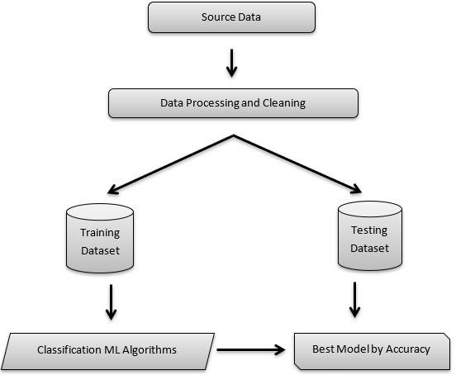
2.Methodology
The analysis of various data mining algorithms, the algorithms that are used in this model :
K nearest neighbours (KNN)
Naïve Bayes
Support Vector Machine
Decision Tree algorithm
Neural Networks
Logistic Regression
Random Forest

Slide 7
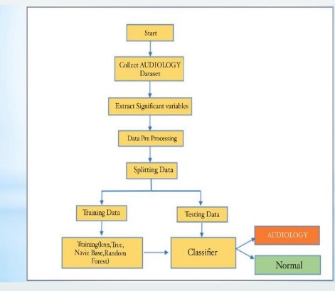
CLASSIFICATION
Classification may be defined as the process of predicting class or category from observed values or given data points.
An example of classification problem can be the spam detection in emails. There can be only two categories of output, “spam” and “no spam”; hence this is a binary type classification.
To implement this classification, we first need to train the classifier. For this example, “spam” and “no spam” emails would be used as the training data.
Types of Learners in Classification:
We have two types of learners in respective to classification problems −
Lazy Learners
K-nearest neighbor and case-based reasoning
Eager Learners
Decision Trees, Naïve Bayes and Artificial Neural Networks (ANN).

Slide 8
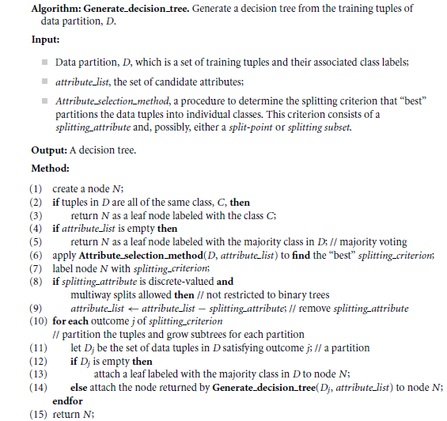
Decision-Tree-Algorithm

Slide 9
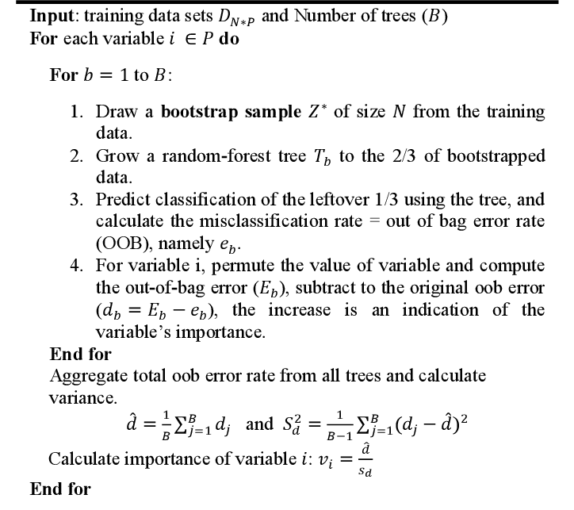
Random Forest Algorithm

Slide 10
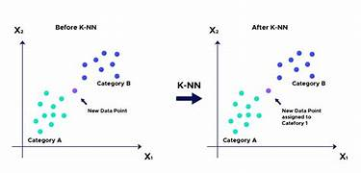
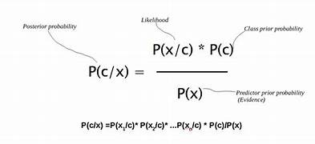
KNN & NAVIE BAYES

Slide 11

3.Orange Tool
The concept of the 'orange tool' presents a fascinating intersection between practicality and symbolism. While its physical form may vary, ranging from a handheld device to a digital interface, its significance extends beyond mere utility.
The orange tool embodies versatility, innovation, and adaptability, serving as a symbol of creative problem-solving in various contexts. Its vibrant hue symbolizes energy and enthusiasm, characteristics often associated with the ingenuity required to wield it effectively.

Slide 12
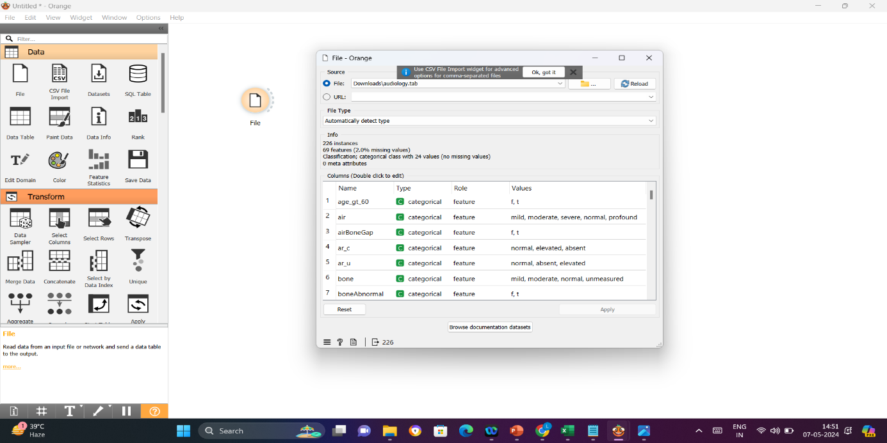
Data Set Description
Age Features
Impact on Audiology
Data Analysis Considerations
Data Mining Techniques
Impact on Hearing and Balance Disorders
Use in Data Mining

Slide 13
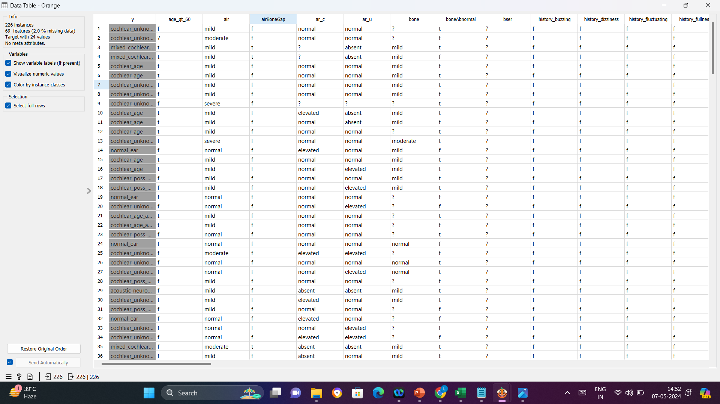
BEFORE PRE PROCESSING

Slide 14
PRE PROCESSING TECHNIQUES
There are several data preprocessing techniques.
Data cleaning can be applied to remove noise and correct inconsistencies in data.
Data integration merges data from multiple sources into a coherent data store such as a data warehouse.
Data reduction can reduce data size by, for instance, aggregating, eliminating redundant features, or clustering.
Data transformations (e.g., normalization) may be applied, where data are scaled to fall within a smaller range like 0.0 to 1.0.

Slide 15
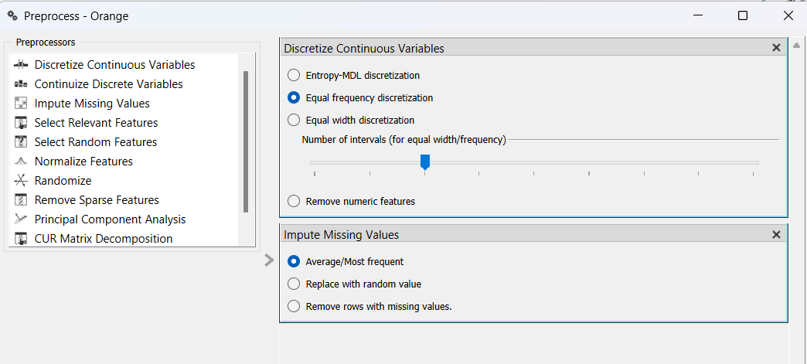
DATA CLEANING
Missing Values
Data entry errors, non-response from participants.
They represent gaps in the dataset.
Handling missing values is essential in data analysis to ensure the integrity and reliability of results.
Deletion involves removing observations or variables with missing values entirely, which may lead to loss of valuable information.
Validation of the chosen approach is essential to assess its impact on analysis results and ensure the robustness of conclusions drawn from the data.

Slide 16
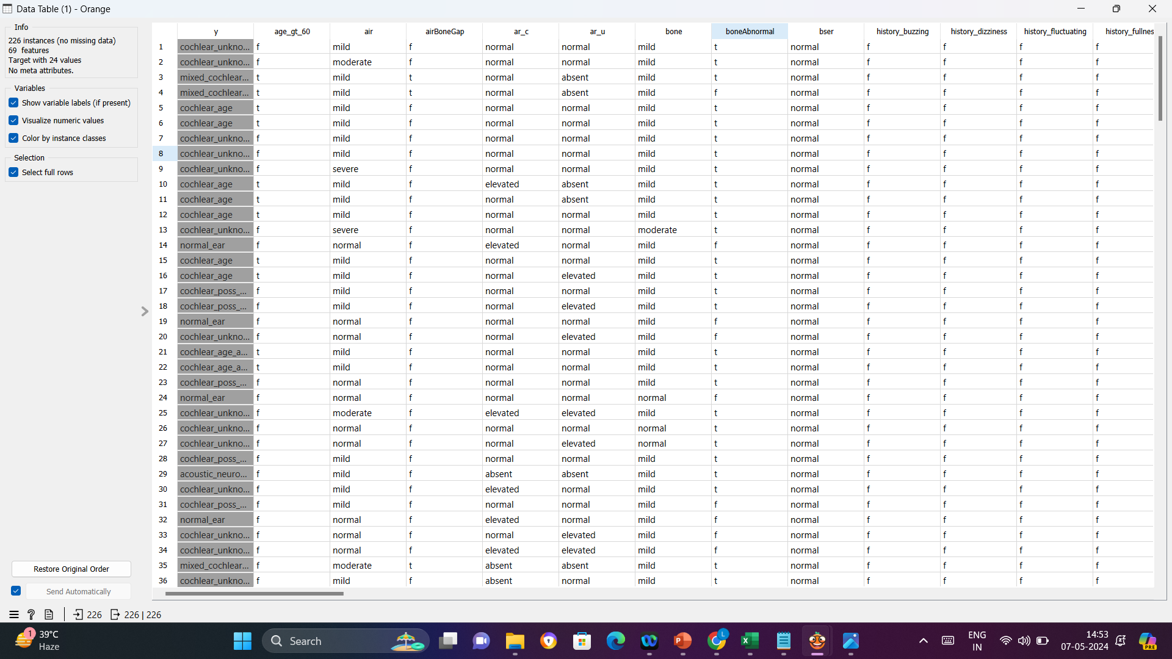
AFTER PRE PROCESSING

Slide 17
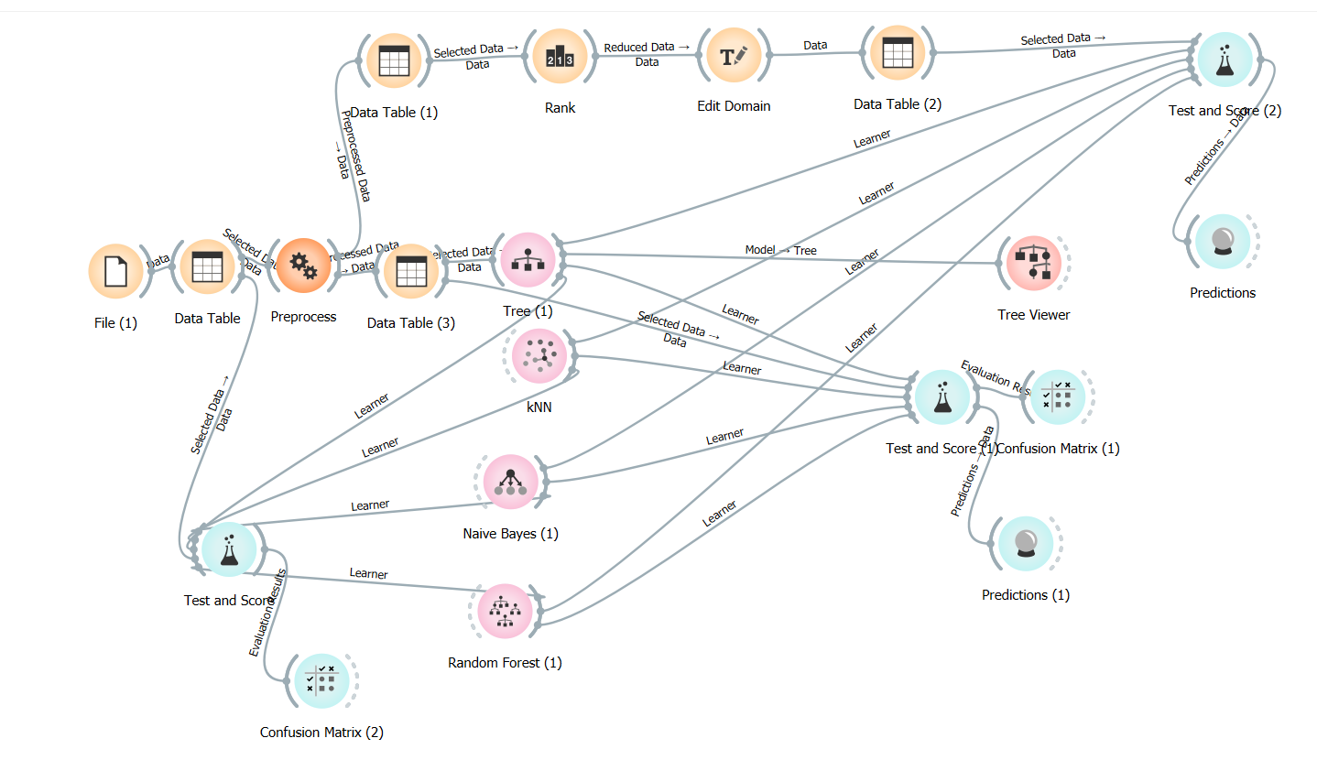
Flow Chart

Slide 18
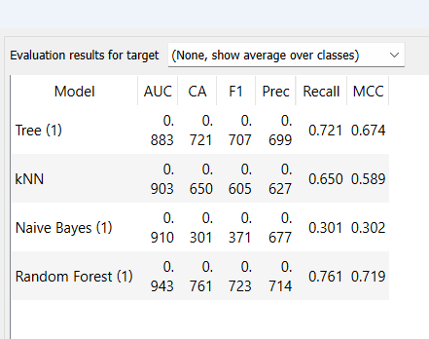
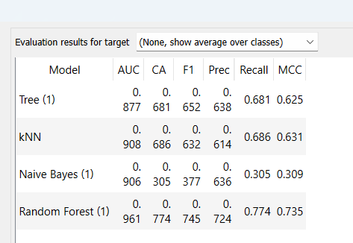
Remove with Value
Before Pre-Process
After Pre-Process

Slide 19
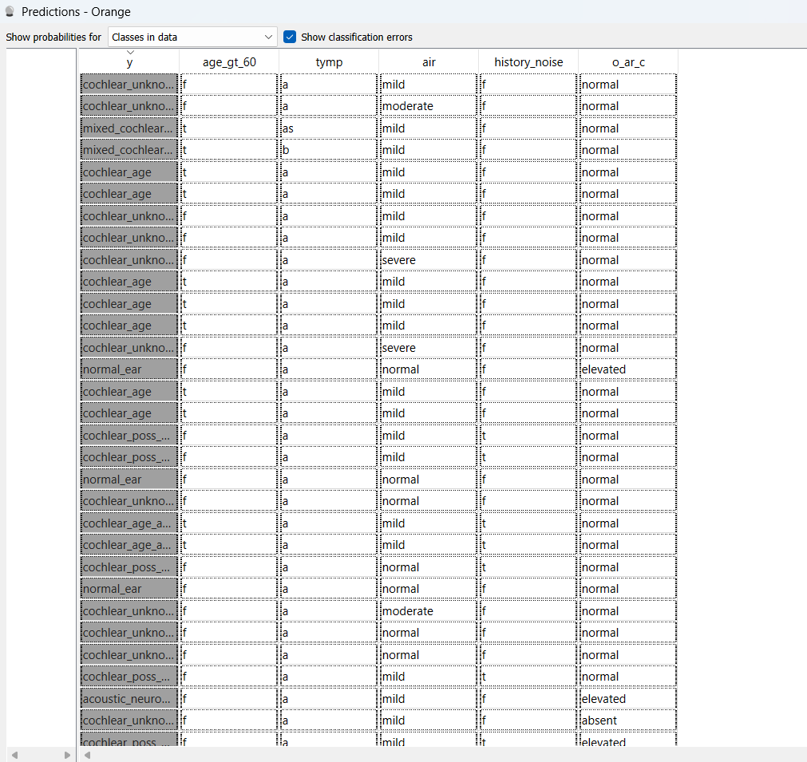
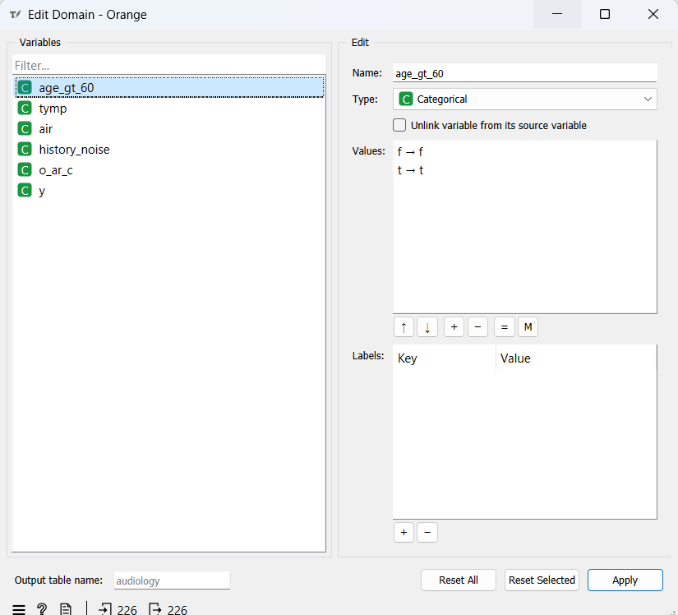
DATA TRANSFORMATION
In data transformation we have taken Top5 entities and their results to calculate it.
While in data transformation we have taken InformationGain,InformationGainRatio,GiniDecrease.
According to this we have taken the Top5 entites values.

Slide 20
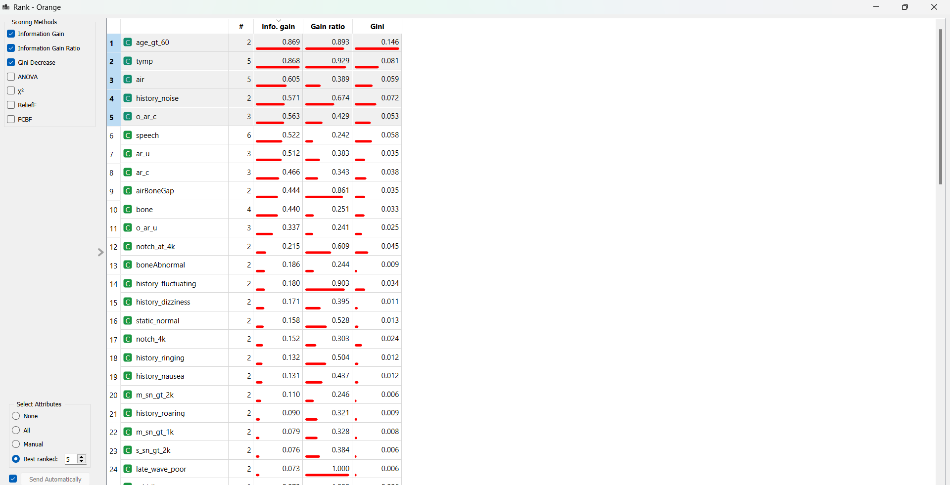
FEATURE SELECTION

Slide 21
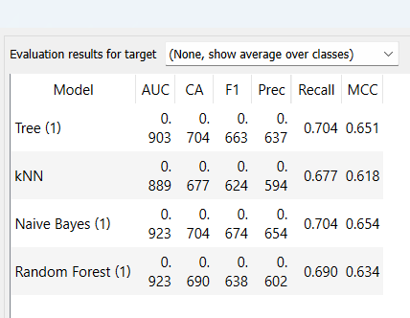
Replacing Missing with user Constant
Before selection
After Selection

Slide 22
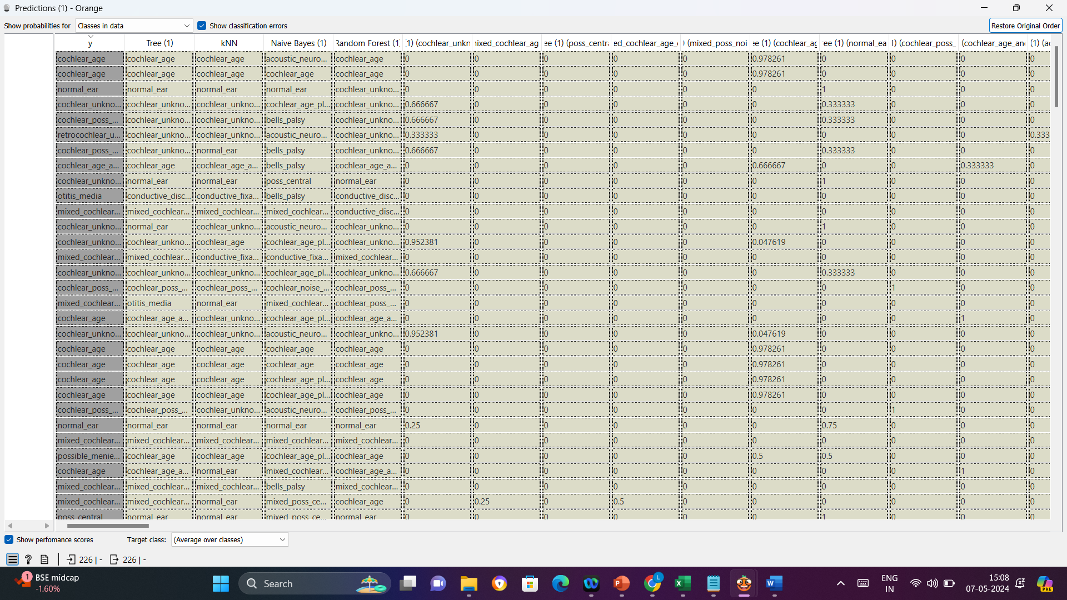
Cofusion matrix

Slide 23
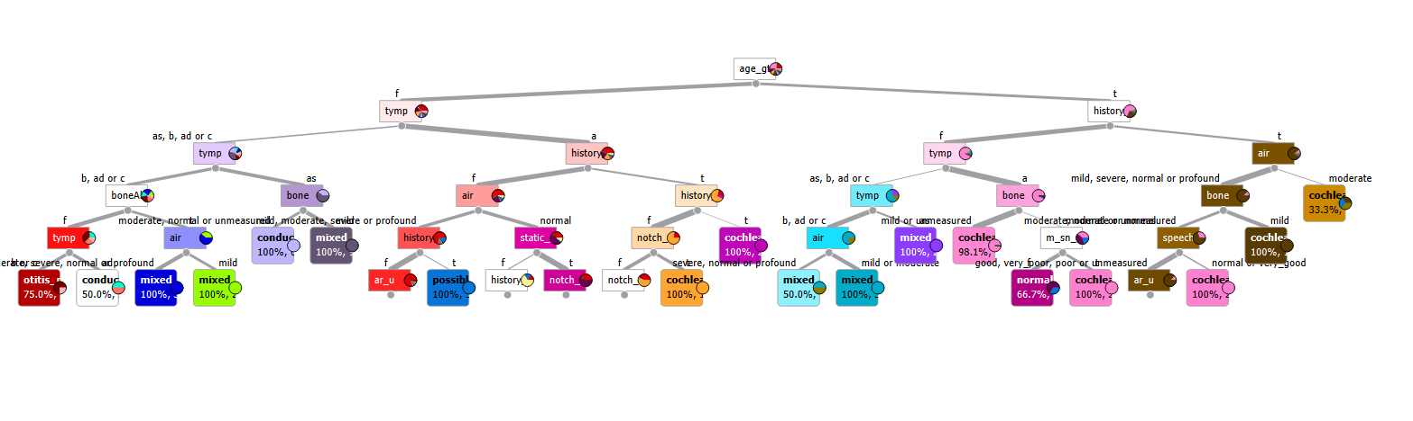
J48: Classify>Choose>trees>J48

Slide 24
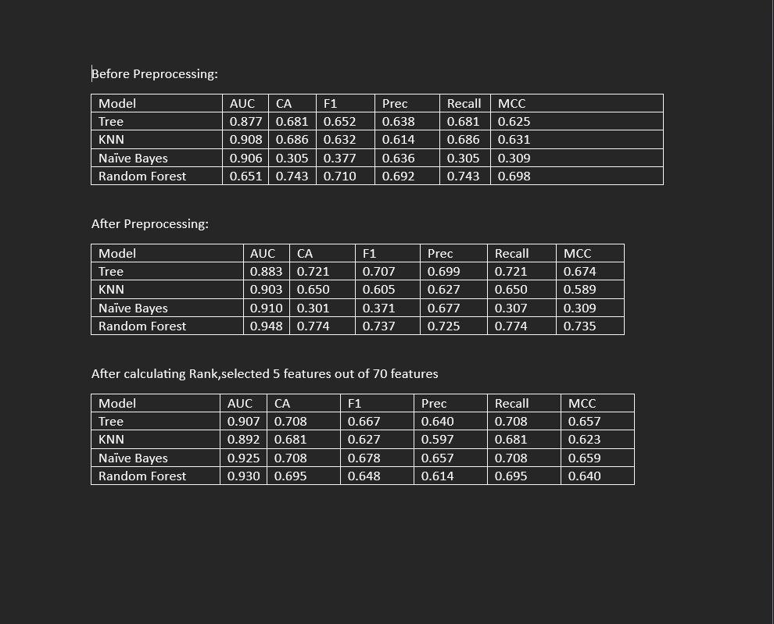
Result

Slide 25
5. CONCLUSION
Before Preprocessing:
Random Forest seems to have good classification accuracy and F1- .core, indicating it's doing a good job of distinguishing between .classes.
KNN has a high AUC but moderate accuracy and F1-score.
Naive Bayes has low accuracy, F1-score, and MCC, suggesting it .may struggle with this data set
After Preprocessing:
Random Forest improves significantly in terms of AUC, CA, F1, .Precision, Recall, and MCC.
Tree model has better performance overall than before preprocessing.
Naive Bayes doesn't see a significant change in its performance.
KNN's performance decreased slightly in most metrics.

Slide 26
After Feature Selection:
Naive Bayes shows the most improvement in AUC and MCC.
Random Forest still performs well with slightly lower CA but similar AUC and MCC.
Tree has slightly lower MCC but good AUC and other metrics.
KNN seems to decline a bit compared to before feature selection.
Overall, you should consider using Random Forest as your primary model, with Naive Bayes as an alternative option, especially after feature selection.

Slide 27
THANK YOU

